Slide 1
Robotic Arms
AI-Based Industrial Maintenance & Process Optimization
Presented By:
01
1.Abhigyan Saini
2.Ankitha KS
3.Azmeera Raghavendar
4.Esha yadav

Slide 2
Introduction
• Robotic arms are widely used in automotive assembly, welding, machining, and manufacturing.
• Continuous operation can lead to wear, overheating, vibration, and component degradation.
• Predictive maintenance uses machine data to identify potential problems before major failures occur.
• Important telemetry parameters include temperature, vibration, voltage, current, RPM, and pressure.
• Process intelligence converts machine and maintenance data into useful operational insights.
• Machine learning analyzes telemetry patterns to identify potential protective-stop or failure conditions.
• A centralized system helps monitor machines, predictions, maintenance, incidents, inventory, and notifications.
• FactoryOps AI integrates these capabilities into a single platform for intelligent robotic-arm monitoring and proactive maintenance.

Slide 3
Problem Statement
• Unexpected robotic-arm failures can cause production downtime and operational delays.
• Traditional scheduled maintenance may not detect developing faults at the right time.
• Continuous monitoring of machine parameters is difficult with manual observation.
• Abnormal temperature and vibration may indicate developing machine problems.
• Large amounts of telemetry data can be difficult to analyze manually.
• Maintenance teams may not have early indications of potential failures.
• Machine, maintenance, incident, and inventory information may be distributed across different records.
• A centralized system is needed to monitor robotic-arm health and support proactive maintenance.
01
02
03
04

Slide 4
04
Objectives
• Develop a centralized platform for monitoring and managing robotic-arm operations.
• Collect and monitor important telemetry data from robotic-arm systems.
• Analyze parameters such as temperature, vibration, voltage, current, RPM, and pressure.
• Detect abnormal machine conditions using telemetry and operational data.
• Apply machine learning to predict potential protective-stop or failure conditions.
• Provide a dashboard for visualizing machine health and prediction results.
• Manage maintenance schedules, incidents, inventory, and operational notifications.
• Support proactive maintenance and data-driven decision-making for robotic-arm operations.
01
02
03
04
05

Slide 5
05
Proposed Solution
• FactoryOps AI provides a centralized platform for robotic-arm monitoring and maintenance management.
• The system collects machine telemetry data from different operational parameters.
• FastAPI processes requests and connects the frontend with the database and prediction services.
• Machine learning analyzes temperature and vibration data to identify potential failure conditions.
• The system displays machine health, telemetry trends, and prediction results through a dashboard.
• Maintenance records and schedules are managed to support proactive maintenance activities.
• Incidents, spare-parts inventory, and notifications are maintained within the same platform.
• The proposed system combines monitoring, prediction, and maintenance information for better operational visibility.
01
02
03
04

Slide 6
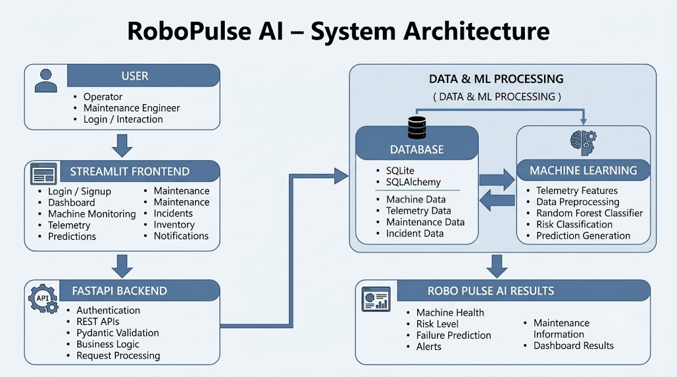
System Architecture
The architecture shows how users interact with RoboPulse AI through the Streamlit frontend, while FastAPI manages APIs and connects the database with the ML system.
The Random Forest model analyzes telemetry data to generate risk predictions, machine health, alerts, and maintenance information displayed on the dashboard.
01
02
04

Slide 7
07
Technology Stack
Category | Technology | Purpose
Frontend | Streamlit | Provides the interactive web dashboard
Backend | Python | Handles API requests and application logic
Programming Language | Python | Used for frontend, backend, ML, and data processing
Machine Learning | Scikit-learn | Model training and prediction
ML Model | Random forest | Used for predictive classification
Model Storage | Pickle (.pkl) | Stores and loads the trained ML model
Database | SQLite | Stores application data
Database ORM | SQLAlchemy | Provides database interaction
Data Processing | Pandas | Data loading, cleaning, and preprocessing
Development Environment | VS Code | Project development and testing

Slide 8

Frontend Implementation
08
• Design an interactive Landing Page to introduce RoboPulse AI.
• Implement a secure Login / Signup Page for user authentication.
• Develop a centralized Dashboard for machine health and system monitoring.
• Provide interactive Monitoring Modules for telemetry, predictions, maintenance

Slide 9
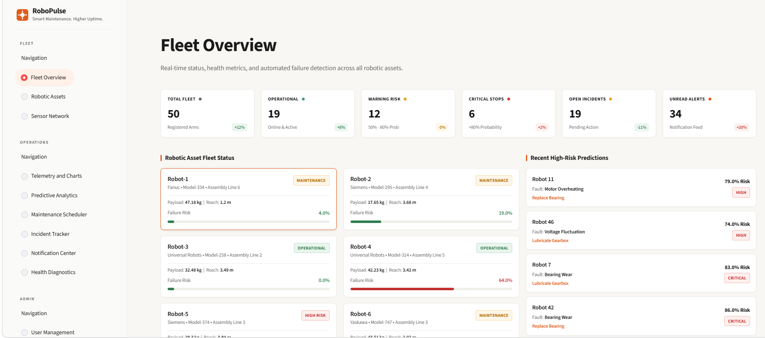
Dashboard & User Interface
09
The Dashboard provides a centralized view of machine health, telemetry, predictions, alerts, and maintenance status.
The User Interface offers simple and interactive screens for monitoring machines and managing maintenance activities.

Slide 10
10
Backend & REST API
• FastAPI REST Backend – Provides the API layer that connects the Streamlit frontend with the backend services.
• API Routing – Handles endpoints for machines, telemetry, predictions, maintenance, incidents, and notifications.
• Request Validation – Uses Pydantic to validate incoming data and ensure correct request/response formats.
• Database Communication – Uses SQLAlchemy with SQLite to store and retrieve machine, telemetry, maintenance, and prediction data.
• AI/ML Integration – Processes machine telemetry through the prediction service to determine failure risk, health status, and remaining useful life.
• JSON Response – FastAPI sends processed results and prediction data back to the Streamlit frontend in JSON format.
• API Flow – Streamlit → HTTP Request → FastAPI → Business Logic → Database/ML → JSON Response → Streamlit Dashboard.

Slide 11
Database Design
•SQLite is used as the primary database for the RoboPulse AI system.
•SQLAlchemy ORM manages communication between the application and database.
•Robot/Machine data contains machine name, location, and operating status.
•Telemetry data captures temperature, vibration, pressure, voltage, current, and RPM.
•Prediction records include failure prediction, risk level, probability, and timestamp.
•Maintenance records help manage maintenance schedules, activities, and status.
•Incident records provide details about incidents, severity, descriptions, and dates.
•Centralized database access connects monitoring, prediction, maintenance, and dashboard modules.
•Data Flow: FastAPI → SQLAlchemy → SQLite → Retrieved Data → AI/ML Analysis → Streamlit Dashboard.

Slide 12
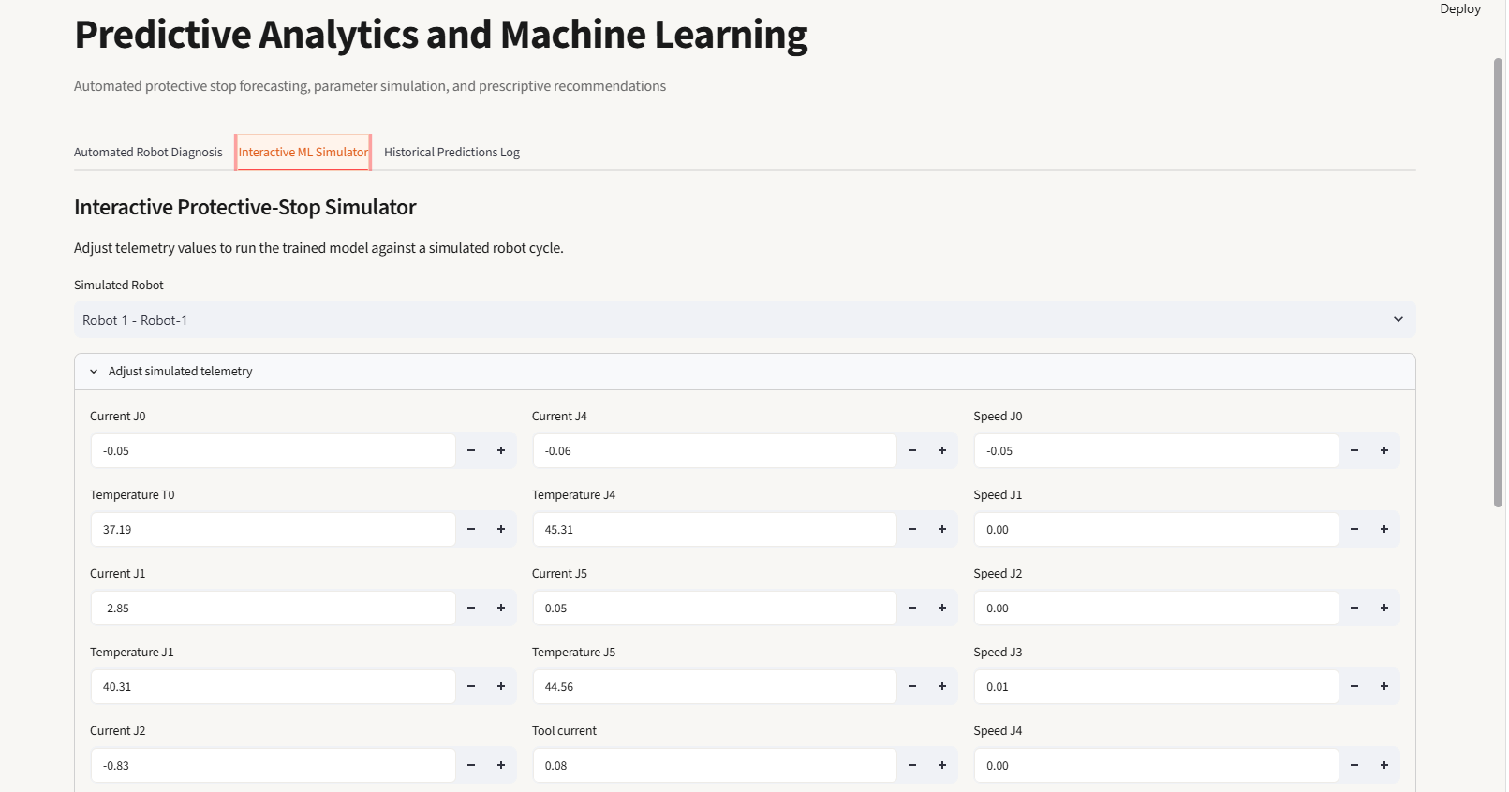
12
AI/ML Prediction System
• Scikit-learn is used to develop the machine learning model.
• Temperature and Vibration Intensity are used as key input features.
• Logistic Regression, Decision Tree, and Random Forest models were compared.
• Random Forest Classifier is used for the final prediction.
• The model learns patterns from historical machine telemetry data.
• It identifies machine conditions associated with potential protective-stop events.
• Prediction results are classified as Normal, Possible Failure, or High Risk.

Slide 13
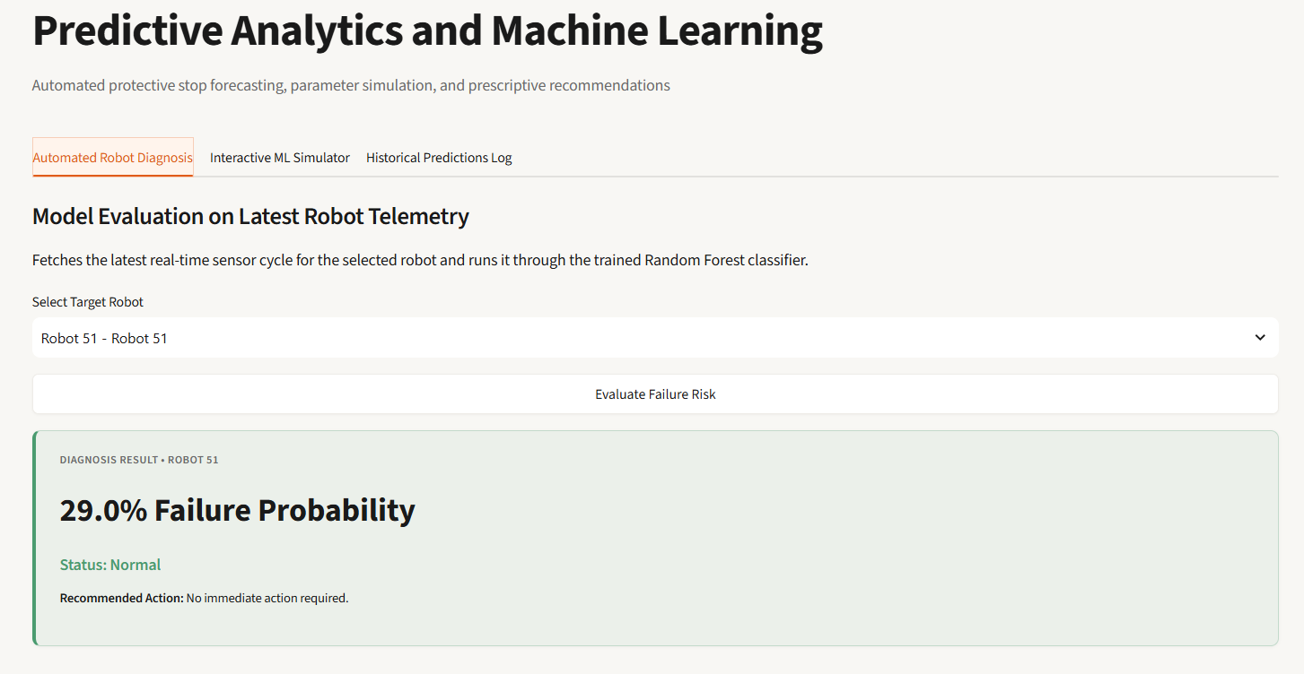
13
Prediction & Analytics Dashboard

Slide 14
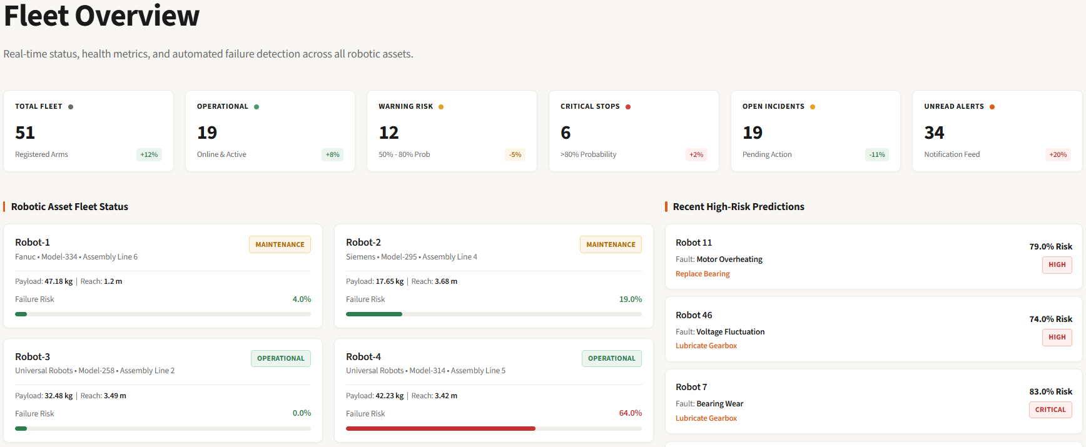
System Results
The system provides a centralized view of robotic-arm performance and health through the dashboard.
It combines telemetry data, Random Forest predictions, alerts, and maintenance information to support proactive machine monitoring.
These results help users track machine conditions, identify potential risks, and plan maintenance activities effectively.

Slide 15
Future Scope
• Real-Time Sensor Integration – Connect RoboPulse AI with live industrial sensors and robotic systems.
• Advanced ML Models – Improve prediction accuracy using advanced machine learning and deep learning techniques.
• Remaining Useful Life (RUL) – Estimate the remaining operational life of machine components.
• Automated Alerts – Send real-time notifications when abnormal conditions are detected.
• IoT Integration – Enable continuous data collection from connected industrial machines.
• Cloud Deployment – Deploy the system on cloud platforms for remote monitoring and scalability.
• Advanced Analytics – Add trend analysis and predictive maintenance insights for better planning.
• Digital Twin Integration – Create virtual machine models for simulation and condition monitoring.

Slide 16
Conclusion
• Developed RoboPulse AI for predictive maintenance and process intelligence.
• Integrated Streamlit, FastAPI, SQLite, SQLAlchemy, and Machine Learning into one application.
• Enables centralized robot monitoring and telemetry management.
• Provides AI-based prediction of potential protective-stop conditions.
• Supports maintenance, incident, inventory, and notification management.
• Presents machine information and prediction results through an interactive dashboard.
• Helps identify potential machine problems for timely maintenance and intervention.
• Provides a foundation for real-time, IoT-enabled, and intelligent industrial maintenance.

Slide 17


